Slide 1
Each of the images is a random sample taken from a population of beetles.

Slide 2
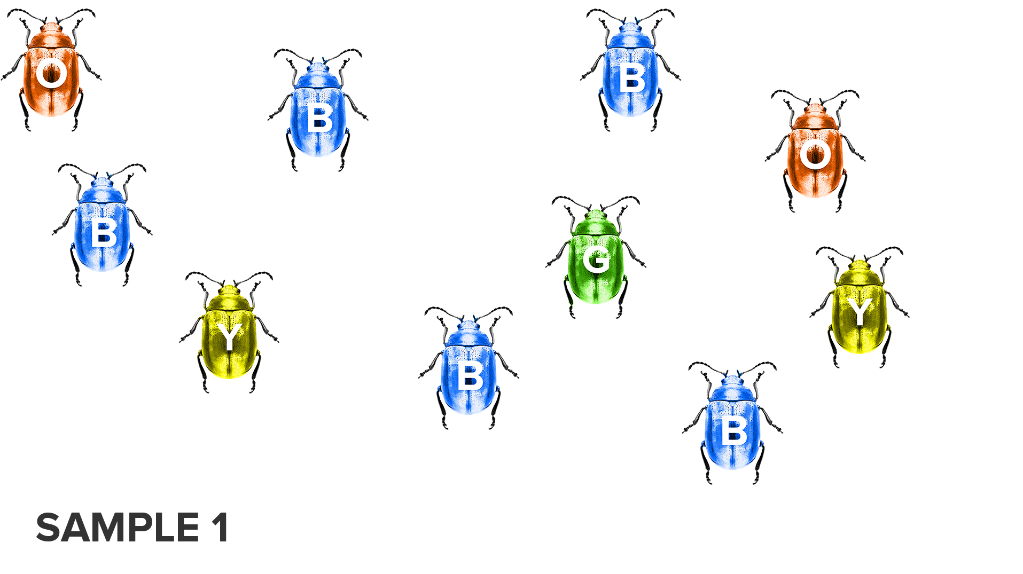

Slide 3
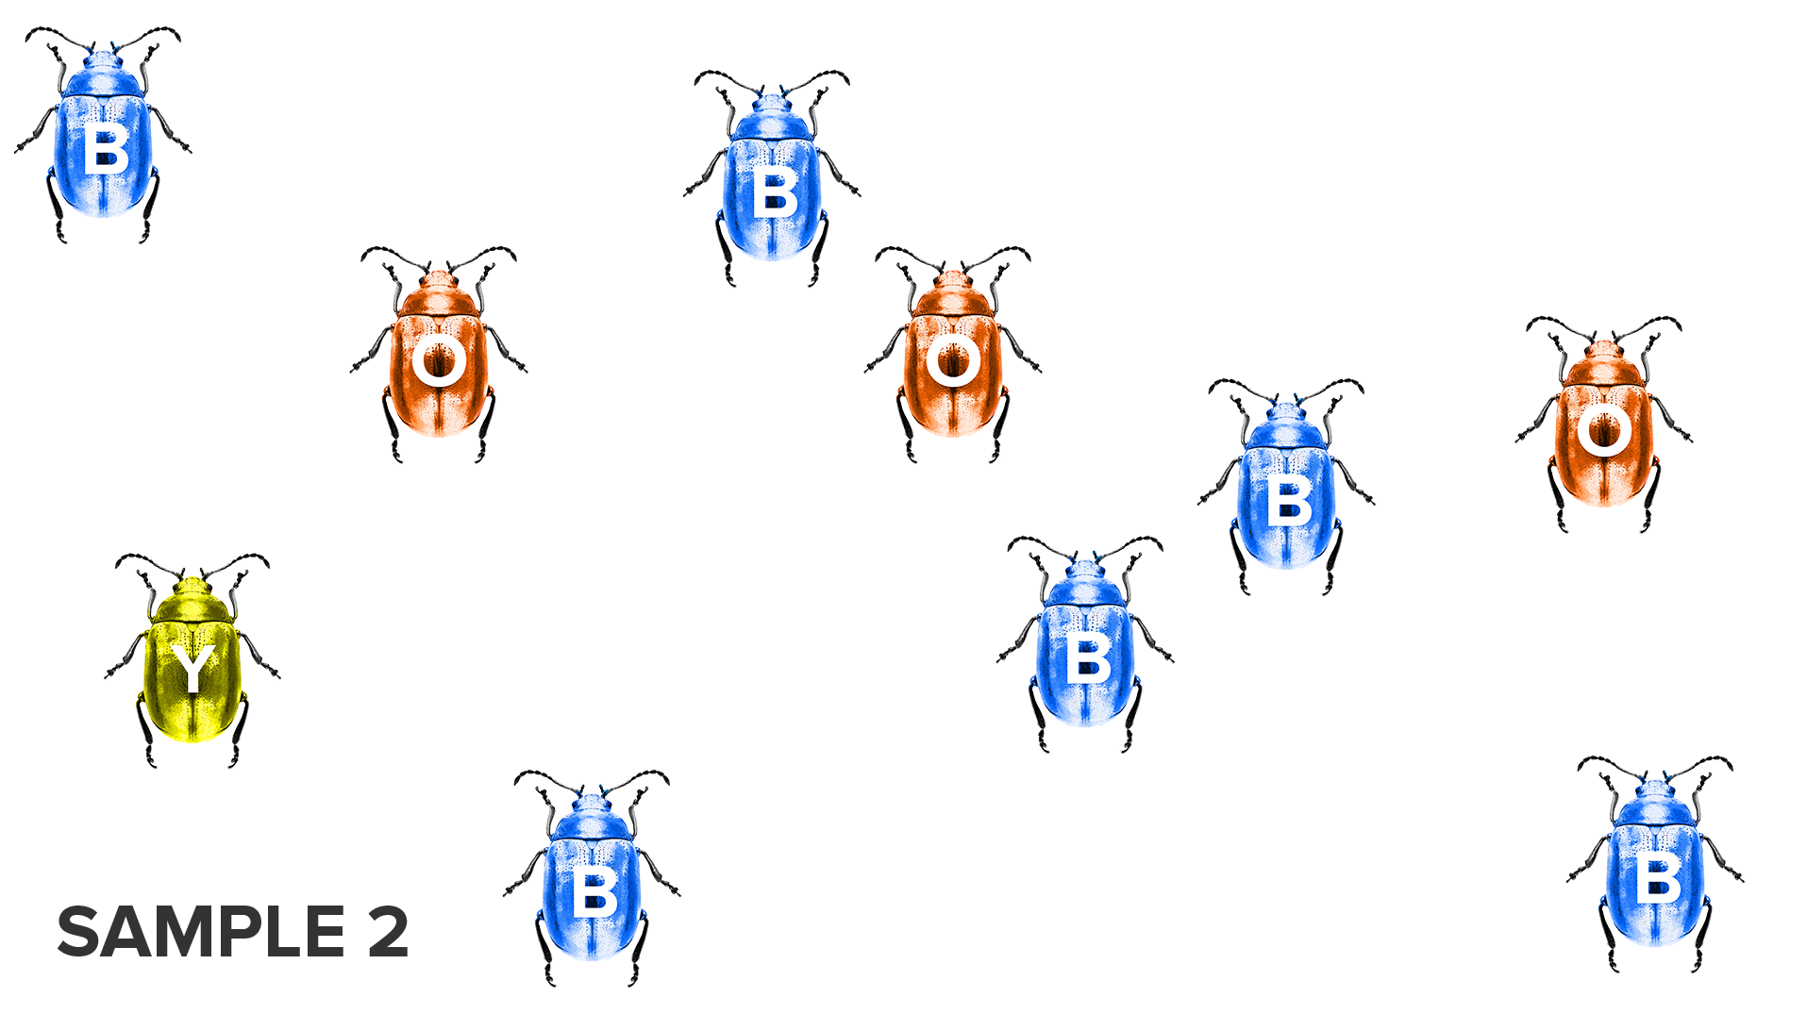

Slide 4
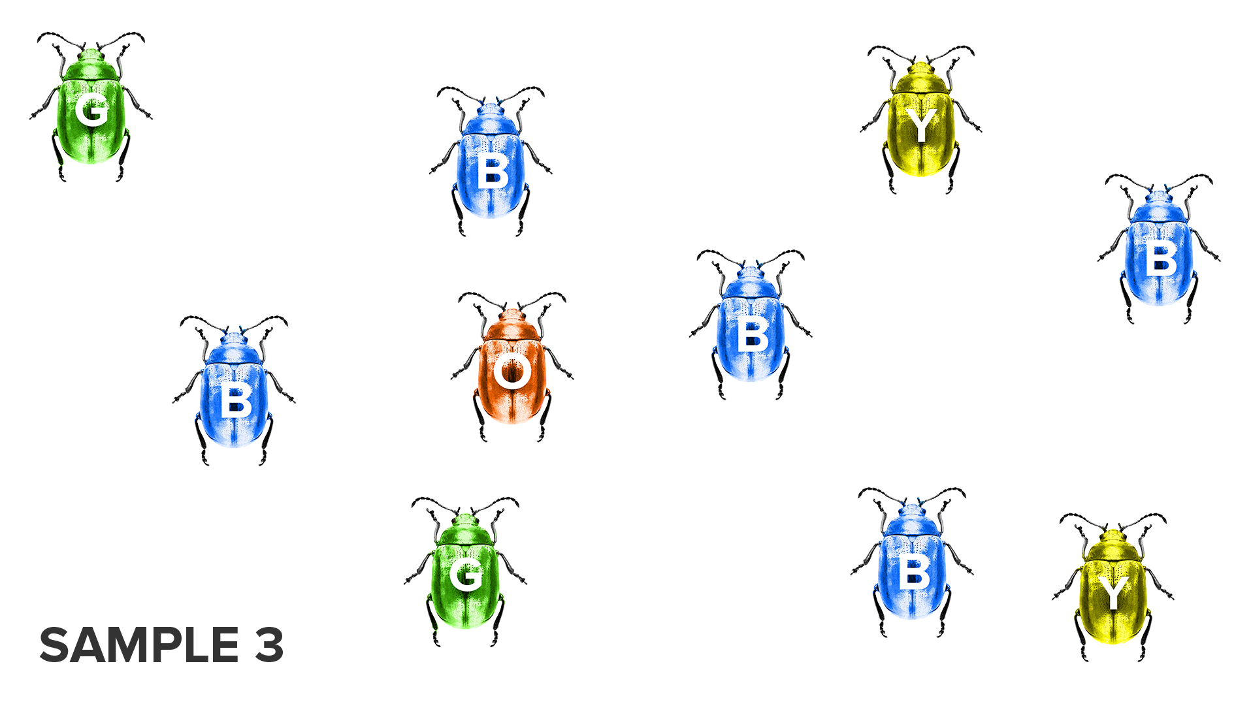

Slide 5
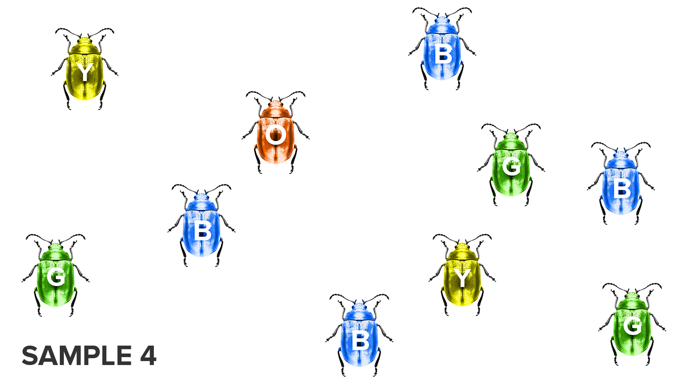

Slide 6
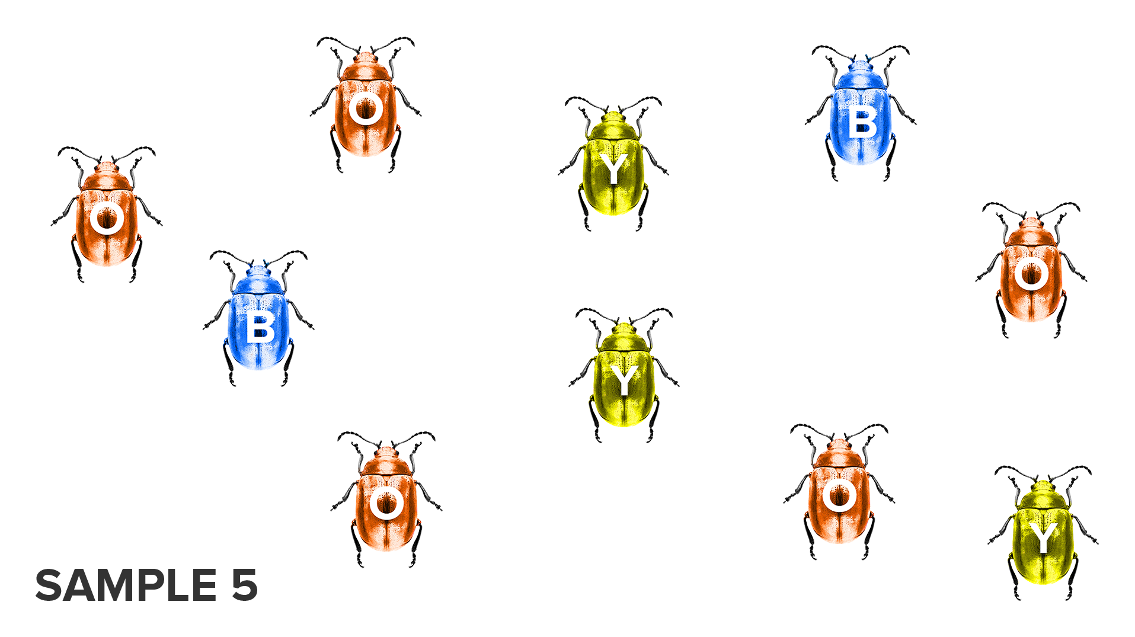

Slide 7
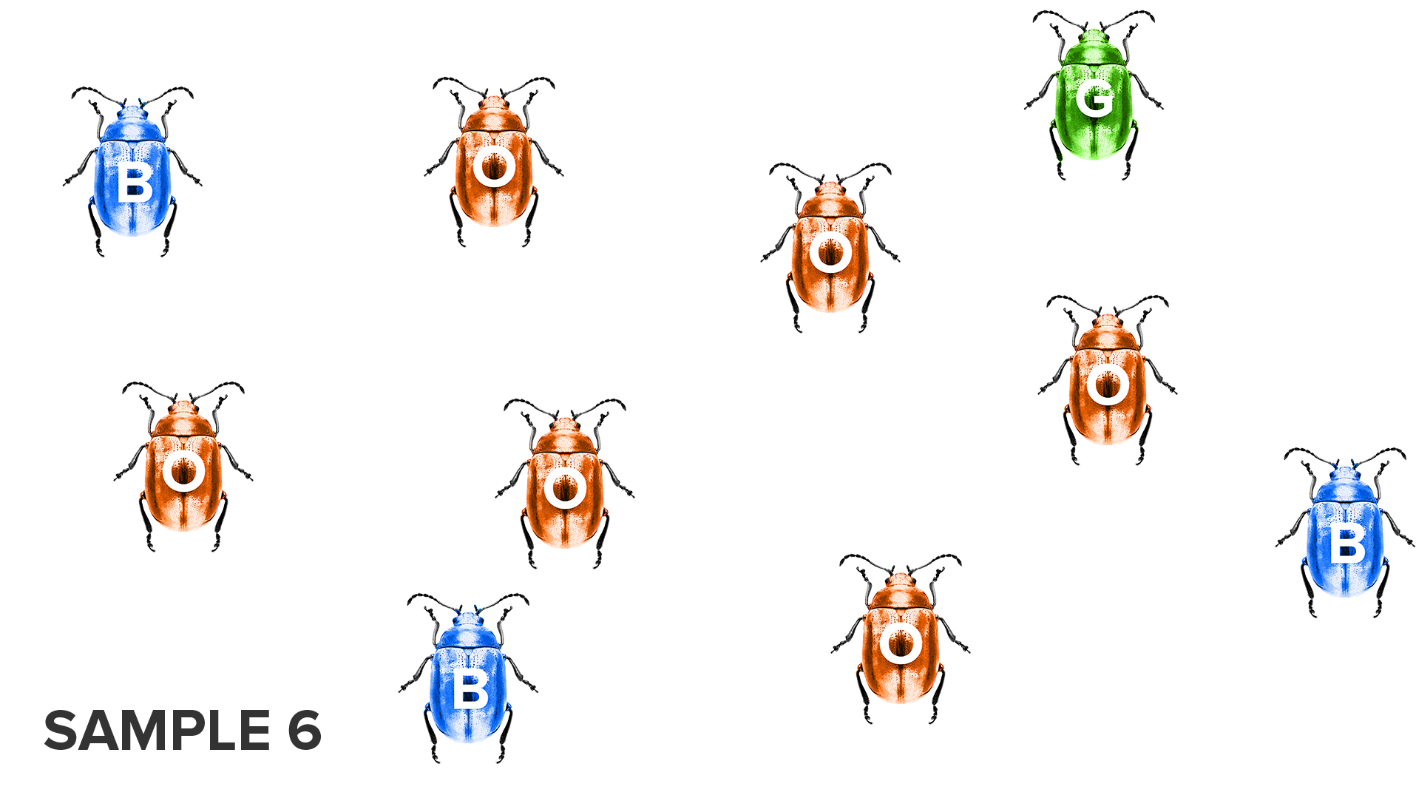

Slide 8
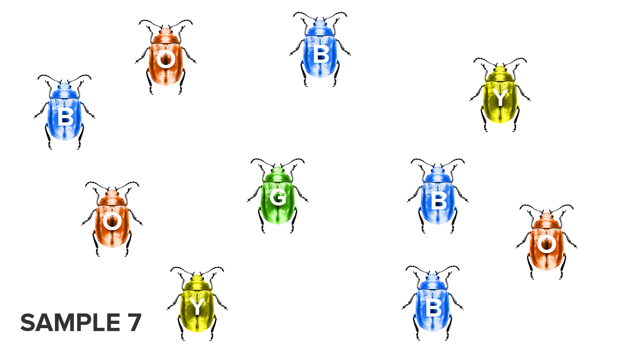

Slide 9
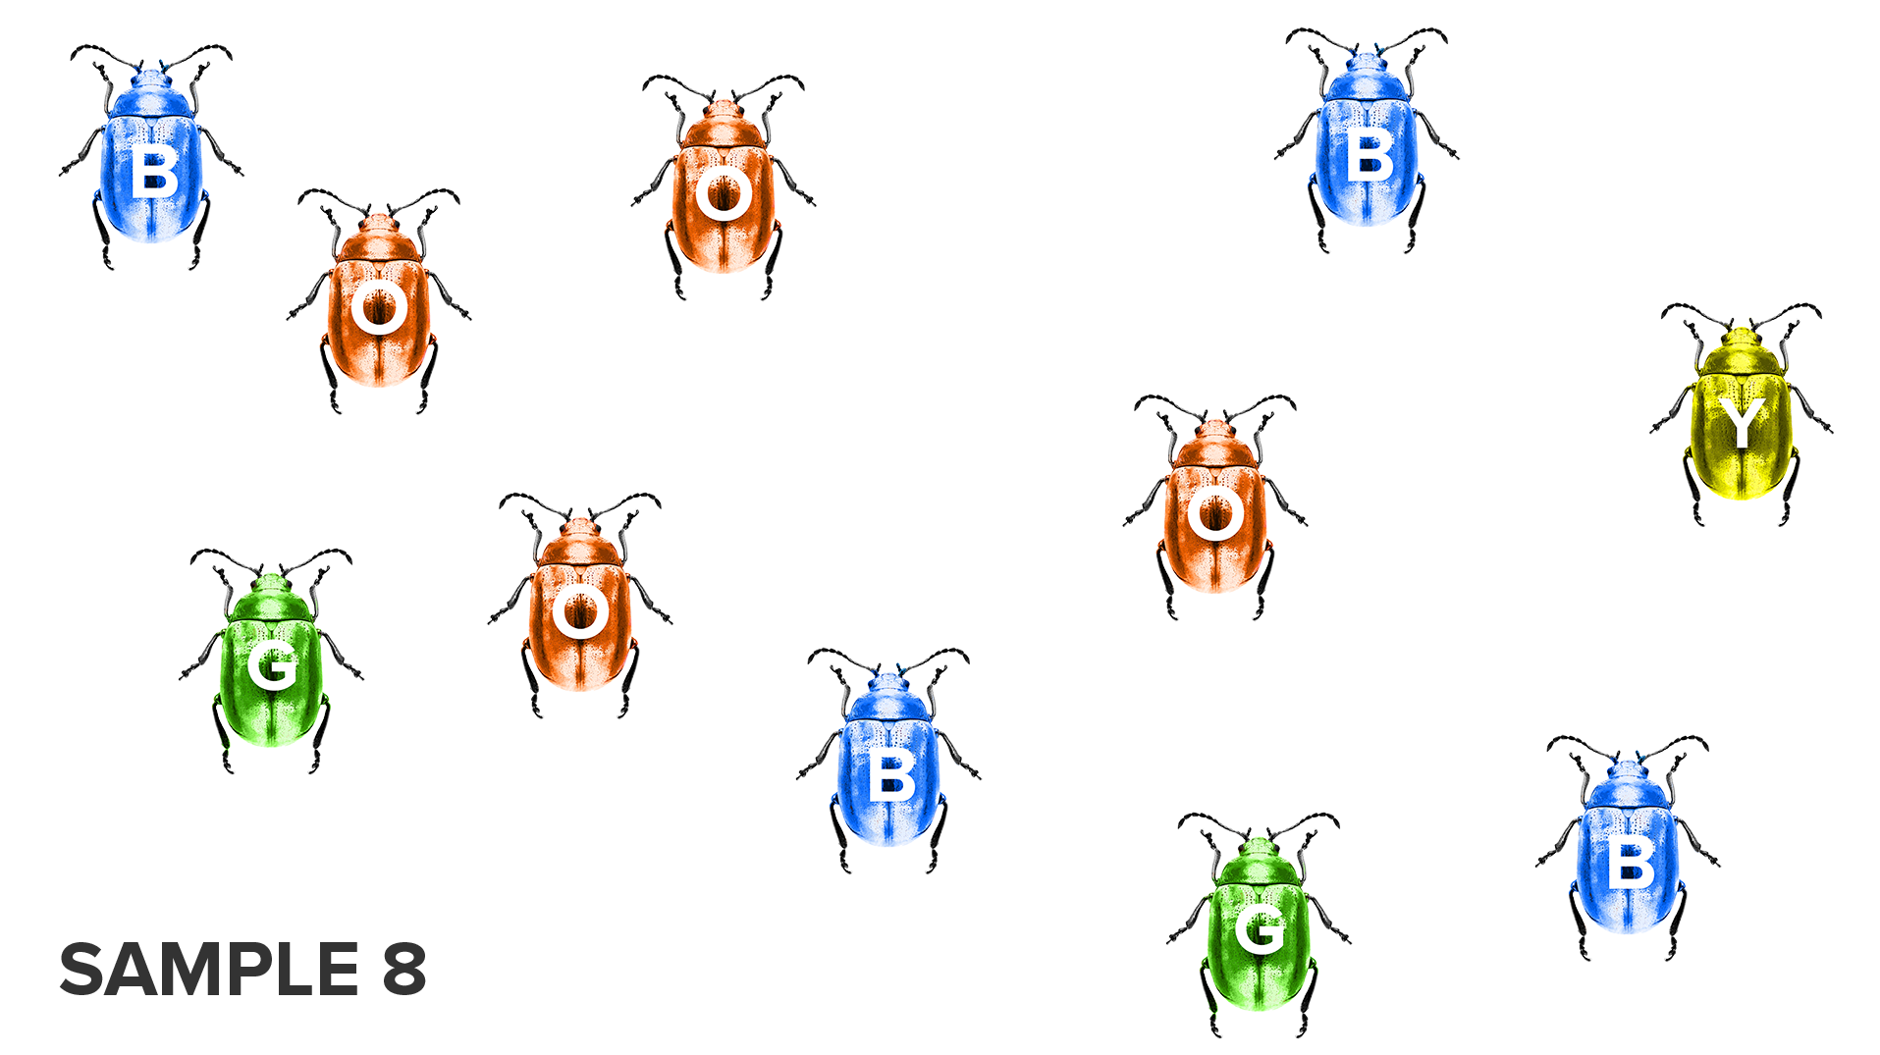

Slide 10
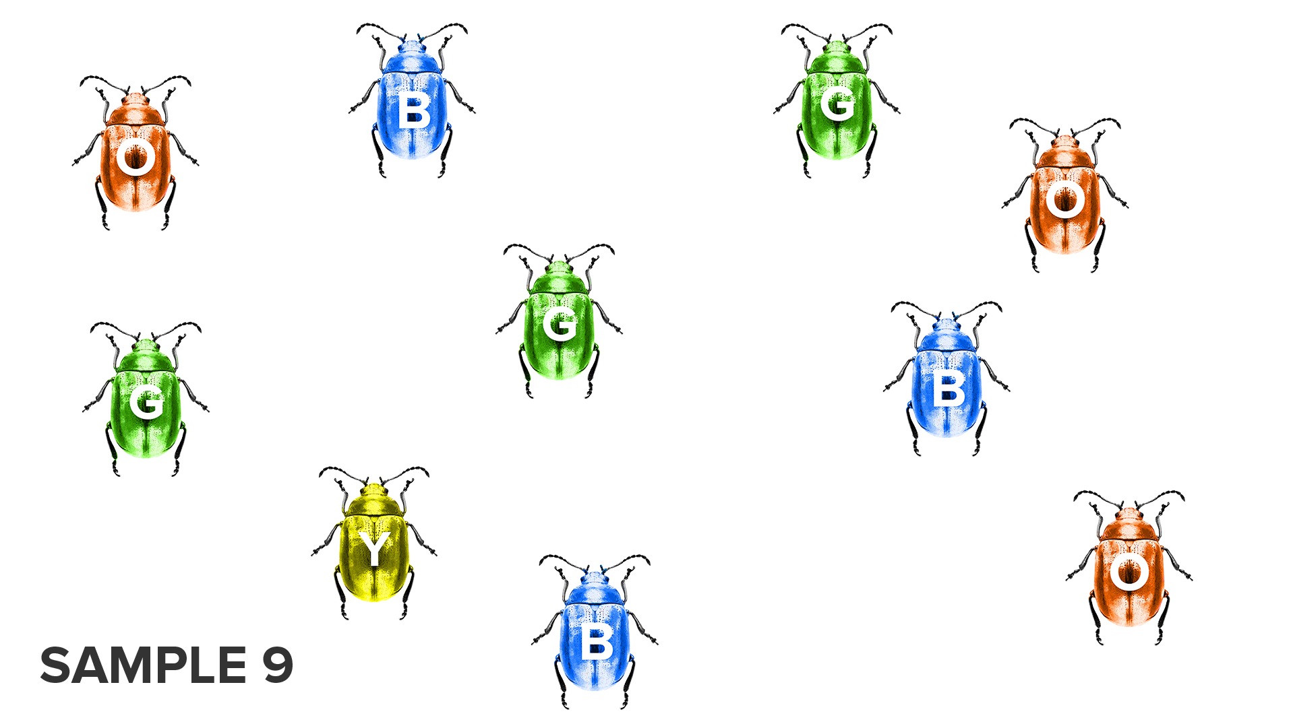

Slide 11
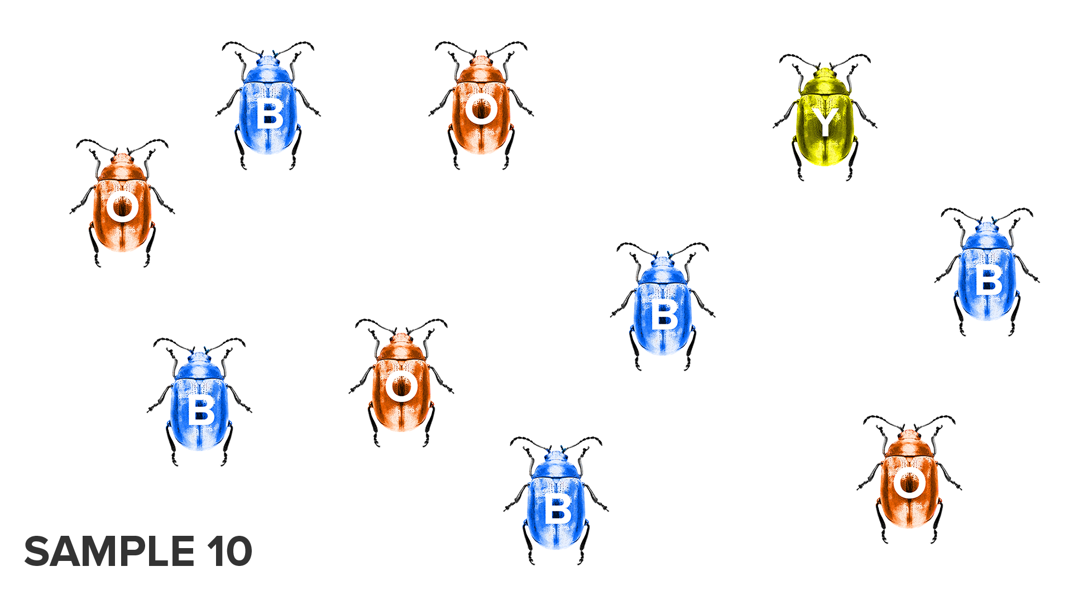

Slide 12
THE NEXT SLIDE IS THE POPULATION BREAKDOWN.
SHOULD BE VIEWED
AFTER THE ACTIVITY

Slide 13
POPULATION BREAKDOWN
TOTAL # BEETLES= 100
ORANGE=31
GREEN=13
YELLOW=15
BLUE=41

